Slide 1
CHAPTER-7

Slide 2
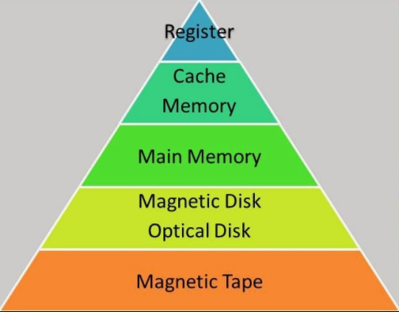
Hierarchical memory system

Slide 3
Contd…
The design constraints on computer memory depends on: - capacity - speed / access time - cost
However, there is a trade-off among these three characteristics and the following relationship is observed. => lesser access time, greater cost per bit. => greater capacity, smaller cost per bit. => greater capacity, greater access time.
Desire=> greater capacity, faster access time, low cost per bit.
Cannot be achieved with single memory component, solution is to organize computer memory into hierarchy.
While moving down the hierarchy, we can observe the following: => Increasing capacity. => Decreasing cost per bit. => Increasing access time / Decreasing speed.

Slide 4
Associative memory(Content Addressable Memory)
This type of memory is accessed simultaneously & in parallel on the basis of data content rather than by specific address or location
When a word is written in an associative memory, no address is given. The CAM checks for location whose valid bit is 0; stores data in that location, sets valid bit to 1. => if no location found, clears location(some algorithm) to store data.
When a word is to be read from an associative memory, the content of word or part of word is specified. The CAM locates all words which match the specified content and mark them for reading.
Uniquely suitable for parallel searches.
More expensive than RAM. Therefore, CAM are used in application where search time is very critical and must be very short.

Slide 5
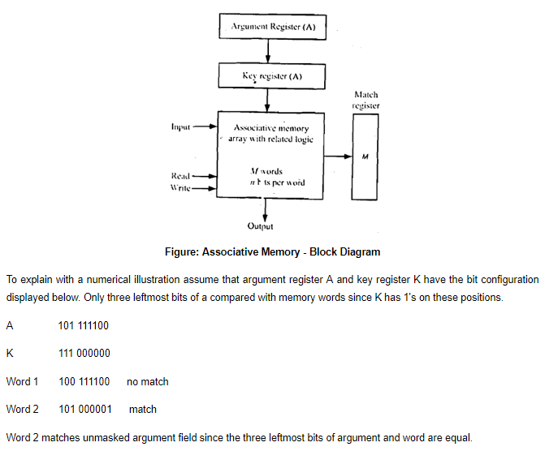
Contd…

Slide 6
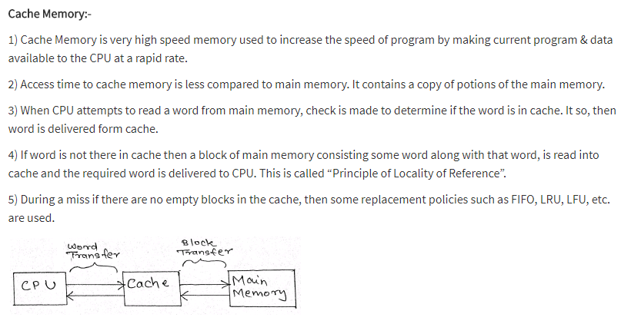
Cache memory:

Slide 7
Cache Mapping Techniques:
The different cache mapping techniques are as follows: => Direct Mapping => Associative mapping => Set Associative mapping
Consider 64K main memory which will be viewed as 4K blocks of 16 word each. i.e. 64K = 2⁶ x 2¹⁰ = 2¹⁶ = 16 – bit address
Consider a cache consisting of 128 blocks of 16 words each, for total of 2048(2K) words.

Slide 8
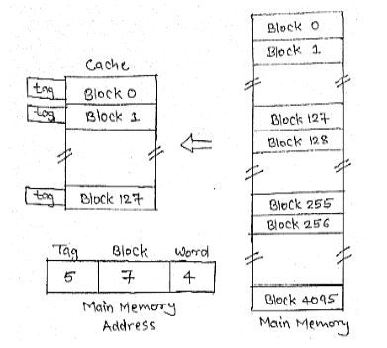
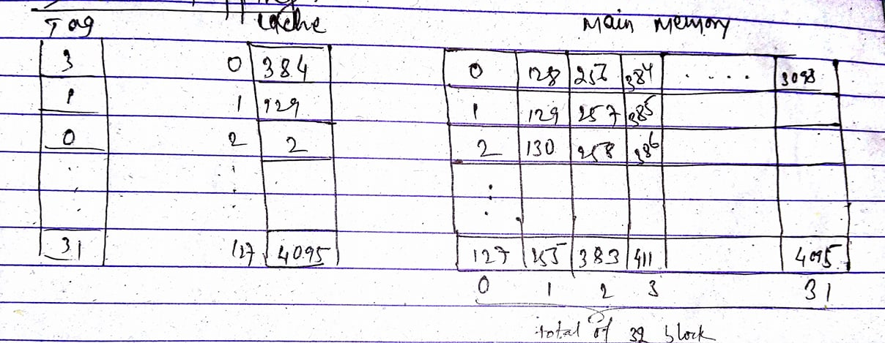
Direct Mapping

Slide 9
Contd…
Mapping function: i = j % m j = main memory block number m = number of cache lines i = cache line number i.e. main memory blocks 0, 128, 256,… is loaded into cache and stored at block 0. Block 1, 129, 257,…are stored at block 1 and so on.
Lower 4-bits select one of the 16 words in a block.
The 7-bit cache block determines the cache line in which the block must be stored.
The leftmost 5-bit is used to identify one of 32 memory block when it is resident in cache.

Slide 10
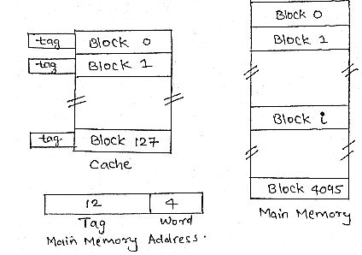
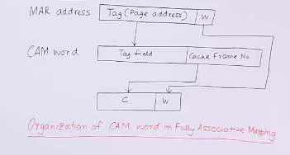
Associative mapping/ Fully associative mapping:

Slide 11
Contd…
Flexible mapping method, in which main memory block can be placed into any cache block position.
In this, 12 tag bits are required to identify a memory block when it is resident in the cache.
CAM contains so many blocks with their respective cache location. It takes 12-bit tag(fig) from the memory address to find whether a particular block is in memory.
The searching is done in all blocks within CAM and in parallel.
Cost of associated mapped cache is higher than the cost of direct mapped because of the need to search all 128 tag pattern to determine whether a block is in cache. This is known as associative search.

Slide 12
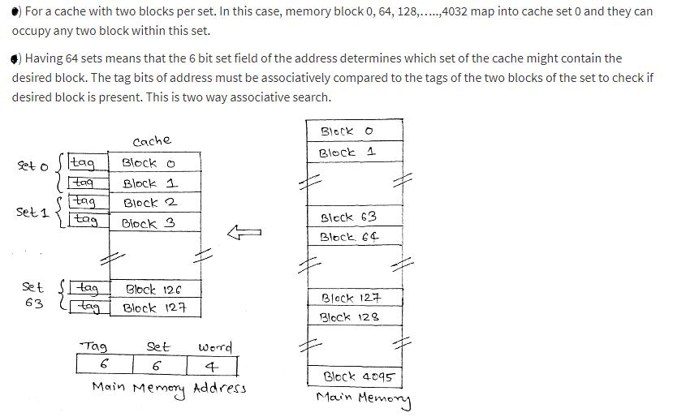
Set associative mapping: => It is the combination of direct and associative mapping technique.

Slide 13
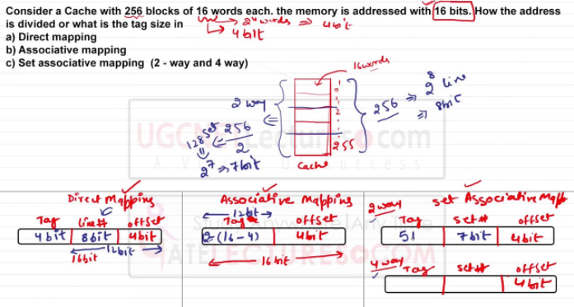
Example

Slide 14
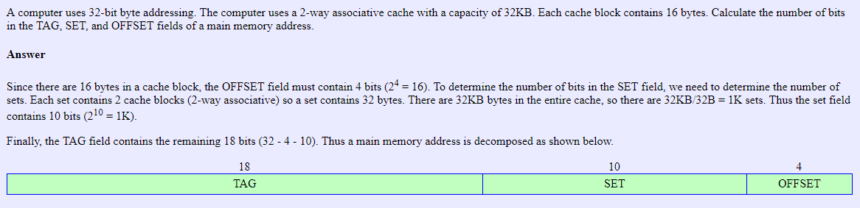
Example contd…

Slide 15
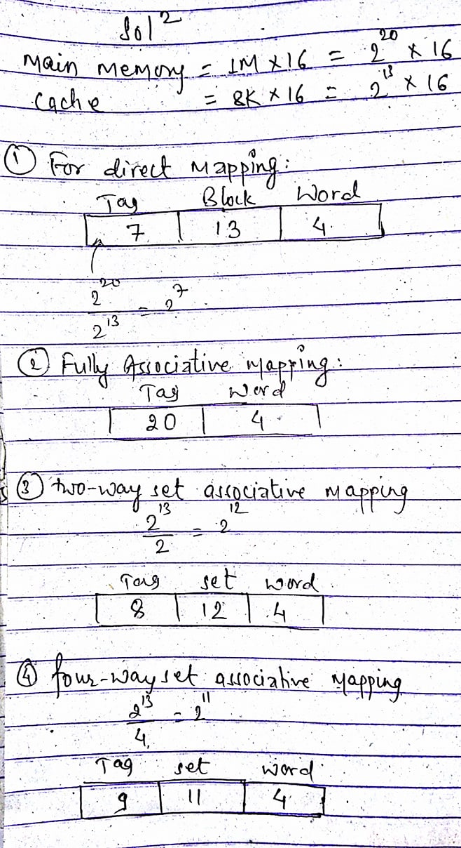
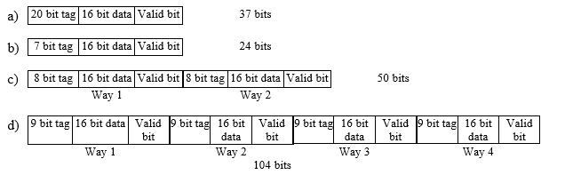
Q. Show the layout of the cache for a CPU that can address 1M x 16 of memory; the cache holds 8K x 16 of data and has the following mapping strategies. Given the number of bits per location and total number of locations as well. i. Fully Associative ii. Direct Mapped iii Two-way associative. iv. Four-way associative.

Slide 16
Replacing data in the cache:
When a computer begins to execute program, it fetches instructions and data from memory, it loads these values into cache.(when particular data is not in cache)
If the computer needs to move data into cache locations that are already occupied, problem becomes deciding which data to move out of cache and how to preserve that data in physical memory.
Direct mapping offers easiest solution to these problem. Since each address in physical memory maps to one specific location in cache, there is no choice to be made about which value will be replaced.
The associative cache allows any location in physical memory to be mapped to any location in the cache. Some replacement policies to select are: => FIFO => LRU => Random
In set-associative cache, each location in physical memory is mapped to one specific location of cache; however, a replacement strategy is needed to determine which way within the location to use.

Slide 17
Writing data to the cache Two methodologies can be used to write data to the cache.
In Write-through, every time value is written from the CPU into a location in the cache, it is also written to the corresponding location in physical memory. => This guarantees that physical memory always contains the correct value, but it requires additional time for the writes to physical memory.
In Write-back, the value written to cache is not always written to physical memory. The value is written to physical memory only once, when data is removed from cache.
Another situation that must be addressed is how to write data to locations not currently loaded into the cache, a write miss.
One possibility is to load the location into cache and then write the new value to cache using either write-back or write-through. This is a write-allocate policy.
A write-no allocate policy, updates the value in physical memory without loading it into the cache.

Slide 18
Cache performances: -primary components of cache performances are cache hits and cache misses.
Every time the CPU accesses memory, it checks the cache. If the requested data is in the cache, it accesses data from cache rather than physical memory, this is a cache hit.
If the data is not in the cache, the CPU accesses the data from main memory (and usually writes the data into the cache as well). This is a cache miss.
Hit ratio is the ratio of total number of hits to the total number of CPU references.
Hit latency is the time taken to find whether required element is in cache or not.
The average memory access time, T_{M} = hT_{c} + (1-h)T_{p} where, h = hit ratio T_{c} = cache access time T_{p} = physical access time

Slide 19
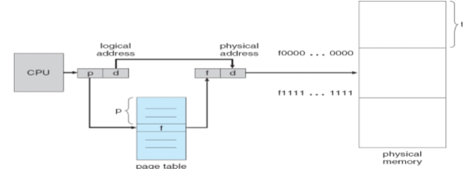
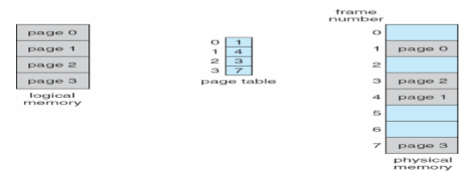
Paging (Avoids external fragmentation, any free frames can be allocated to a process that needs it.)

Slide 20
Contd…
Physical memory is broken into blocks of the same size of pages, called memory frames.
When a process is to be executed, its pages are loaded into any available memory frames.
Every logical address generated by CPU is divided into any two parts: page number(p) and offset(d).
The page number is used as an index for page table, that contains base address. The base address is combined with offset address to define physical address.
If there are n pages in process, there must be at least n available frames to allocate the arriving process.
The first page is loaded into one of the memory frame and the corresponding frame number is put into the page table. This process is repeated for all the pages.

Slide 21
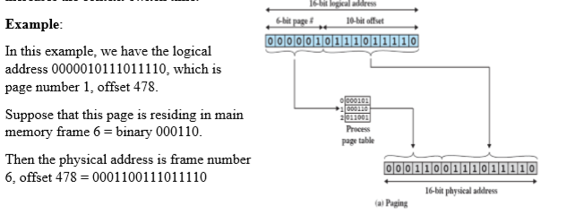
Contd…

Slide 22
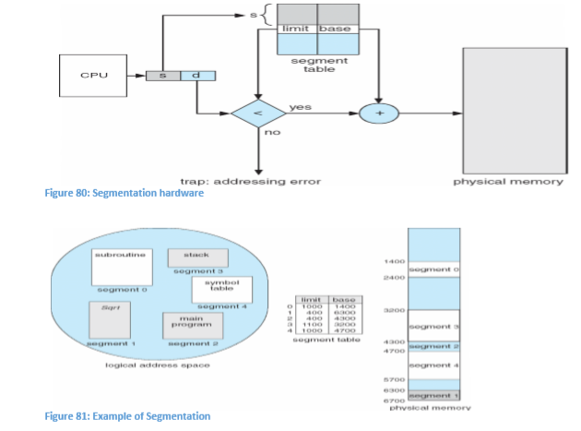
Segmentation

Slide 23
Contd…
In segmentation, program and its associated data are divided into number of segments such as: main program, procedure, function, local variables, global variables, stack, arrays, etc.
The segments of program are of variable length.
The logical address generated by CPU using segmentation consists of two parts, segment number and offset.
Eliminates internal fragmentation, but like dynamic partitioning, suffers from external fragmentation.
Segmentation contains the segment table containing starting address of segment. It also contains length of segment to assure that invalid addresses are not used.
When the process enters the running state, the address of the segment table is loaded into memory.
If segment number(s) < segment table length register(STLR), physical address is obtained, else addressing error.

Slide 24
Virtual memory
Is a technique that allows execution of process that may not be completely in memory.
Main advantage of this scheme is that program can be larger than physical memory.
In virtual memory, program need not be fully loaded into main memory, only those portion execution of program is loaded.
Example: => error handling routines are used only when error occurs in the data or computation. => certain feature of program is used rarely. =>small portion of table is loaded instead of whole table.
Advantages: => less number of I/O would be required to load or swap program into memory. => program would no longer be constrained by the amount of physical memory available. => takes less physical memory, so many program can be run at the same time.

Slide 25
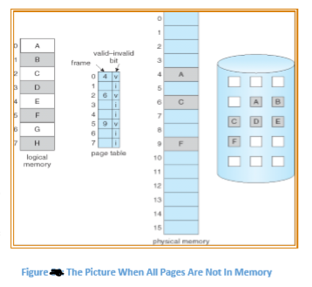
Demand paging: - similar to paging system with swapping.

Slide 26
Contd…
When we want to execute a process, we swap it into memory. Rather than swapping entire process, we only swap a page needed for execution. This is done by lazy swapper.
Thus, some pages of process will be in memory and the other pages in the disk.
Hence, a hardware support is required to distinguish between those pages that are on disk and on memory. This is done by using valid bit-invalid bit scheme.
When the process tries to use the pages that is in memory, execution proceeds normally and when it tries to use the page that was not brought in memory, it results page fault trap.

Slide 27
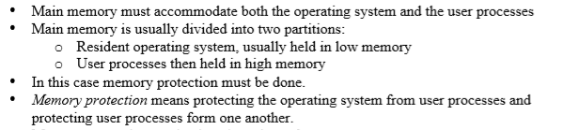
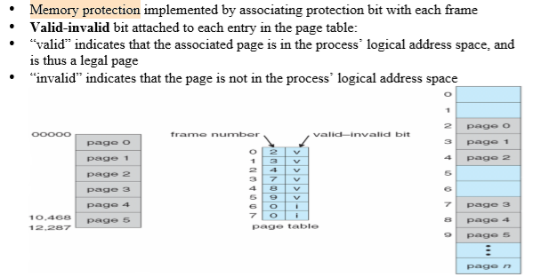
Memory protection:

Slide 28
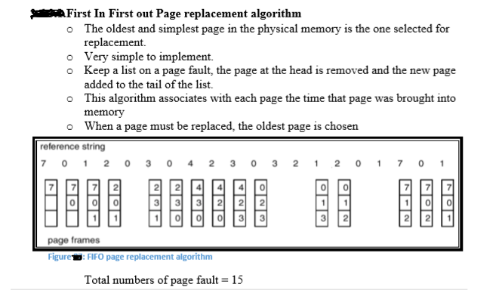
Page Replacement Algorithm - when there are more pages than the memory frames, then the page from the frame must be loaded out so as to load the unloaded page into the memory. - replacing the pages in the memory follows certain algorithm.

Slide 29
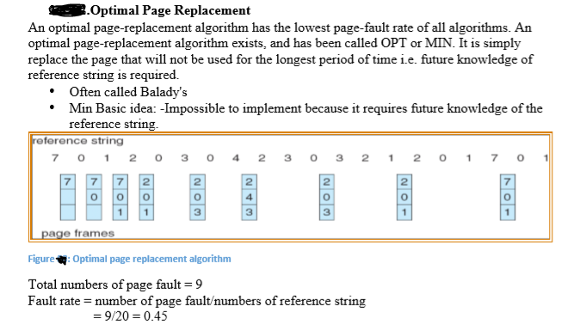
Contd…

Slide 30
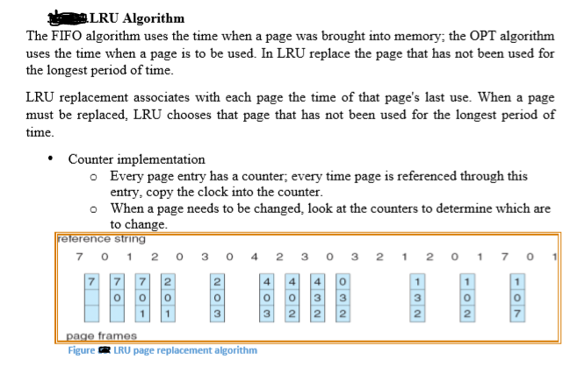
Contd…

